Slide 1
Biological Membranes and Transport
Presented by:
Dr. Kalpana Jorasia
Assistant professor(VBC)

Slide 2
The plasma membrane is an envelope surrounding the cell. lt separates and protects the cell from the external hostile environment.
Chemical composition
The membranes are composed of lipids, proteins and carbohydrates. The actual composition differs from tissue to tissue.
Among the lipids, amphipathic lipids (containing hydrophobic and hydrophilic groups) namely phospholipids, glycolipids and cholesterol, are found in the animal membranes.
Many animal cell membranes have thick coating of complex polysaccharides referred to as glycocalyx. The oligosaccharides of glycocalyx interact with collagen of intercellular matrix in the tissue.

Slide 3
Structure of membranes
A lipid bilayer model originally proposed for membrane structure in 1935 by Davson and Danielle has been modified.
Fluid mosaic model, proposed by Singer and Nicolson, is a more recent and acceptable model for membrane structure.
The biological membranes usually have a thickness of 5-8 nm.
A membrane is essentially composed of a lipid bilayer.
The hydrophobic (nonpolar) regions of the lipids face each other at the core of the bilayer while the hydrophilic (polar) regions face outward.
Globular proteins are irregularly embedded in the lipid bilayer. Membrane proteins are categorized into two groups.

Slide 4
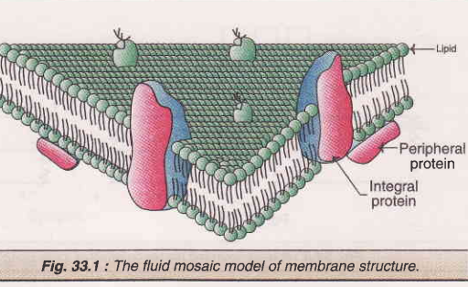

Slide 5
1. Extrinsic (peripheral) membrane proteins are loosely held to the surface of the membrane and they can be easily separated e.g. cytochrome c of mitochondria.
2. Intrinsic (integral) membrane proteins are tightly bound to the lipid bilayer and they can be separated only by the use of detergents or organic solvents e.g. hormone receptors, cytochrome P₄₅₀.
The membrane is asymmetric due to the irregular distribution of proteins.

Slide 6
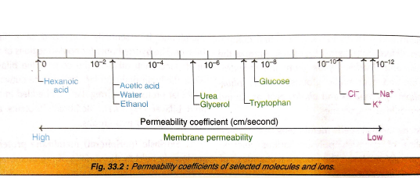
Permeability coefficient: It represents the measure of the ability of a molecule to diffuse across a biological membrane.
The permeability coefficients of molecules correlate with their solubilities in non-polar solvents.

Slide 7
Transport across membranes
The biological membranes are relatively impermeable. The membrane, therefore, forms a barrier for the free passage of compounds across it.
At least three distinct mechanisms for the transport of solutes (metabolites) through the membrane
1. Passive diffusion
2. Facilitated diffusion
3. Active transport

Slide 8
1. Passive diffusion : This is a simple process which depends on the concentration gradient of a particular substance across the membrane.
Example: passage of water and gases
This process does not require energy.
2. Facilitated diffusion : This is somewhat comparable with diffusion since the solute moves along the concentration gradient (from higher to lower concentration)
No energy is needed.
Facilitated diffusion occurs through the mediation of carrier or transport proteins. Specific carrier proteins for the transport of glucose, galactose, leucine, phenylalanine etc. have been isolated and characterized

Slide 9
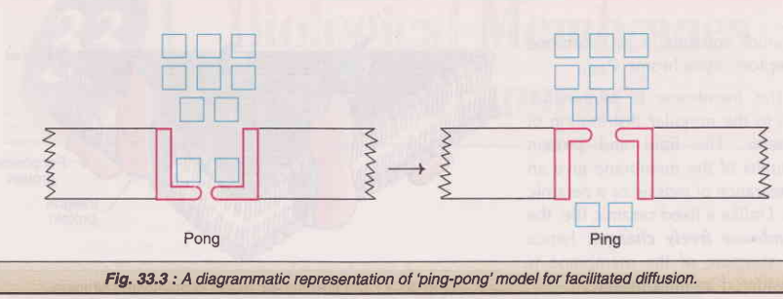
Mechanism of facilitated diffusion : A ping pong model is put forth to explain the occurrence of facilitated diffusion.
According to this mechanism, a transport (carrier) protein exists in two conformations. In the pong conformation, it is exposed to the side with high solute concentration. This allows the binding of solute to specific sites on the carrier protein. The protein then undergoes a conformational change (ping state) to expose to the side with low solute concentration where the solute molecule is released. Hormones regulate facilitated diffusion. For instance, insulin increases glucose transport in muscle and adipose tissue; amino acid transport in liver and other tissues.

Slide 10
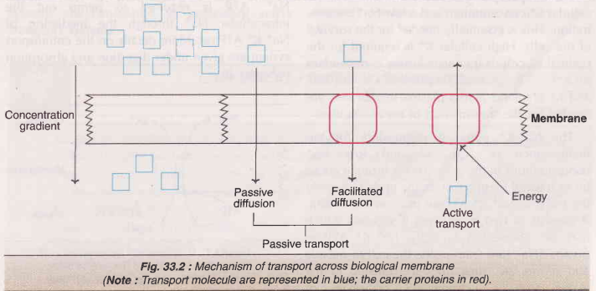

Slide 11
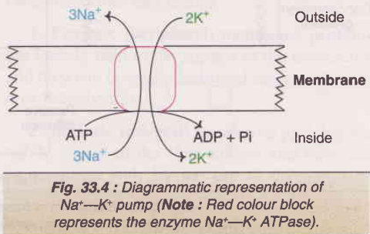
3. Active transport : Active transport occurs against a concentration gradient and this is dependent on the supply of metabolic energy (ATP).
Active transport is also a carrier mediated process like facilitated diffusion. The most important primary active transport systems are ion-pumps (through the involvement of pump ATPases or ion transporting ATPases). Example: Na⁺-K⁺ pump.
A major portion of the cellular ATP (up to 70, in nerve cells) is in fact utilized by Na⁺-K⁺ pump to maintain the requisite cytosolic Na⁺ and K⁺ levels.
Ouabain inhibits Na+-K+ ATPase.

Slide 12
Transport systems
The transport systems may be divided into 3 categories .
1. Uniport system : This involves the movement of a single molecule through the membrane e.g. transport of glucose to the erythrocytes.
2. Symport system : The simultaneous transport of two different molecules in the same direction e.g. transport of Na+ and glucose to the intestinal mucosal cells from the gut.
3. Antiport system : The simultaneous transport of two different molecules in the opposite direction. e.g exchange of Cl- and HCO₃ in the erythrocytes.
Uniport, symport and antiport systems are considered as secondary active transport systems.

Slide 13
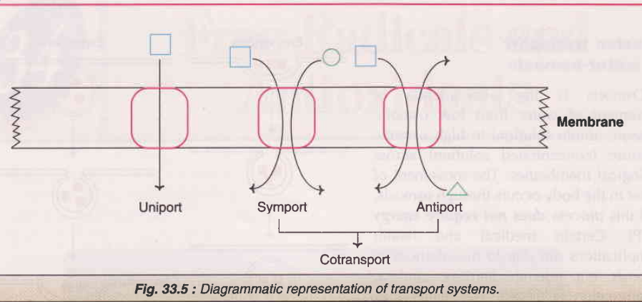

Slide 14
Cotransport system : In cotransport, the transport of a substance through the membrane is coupled to the spontaneous movement of another substance.
The symport and antiport systems referred to above are good examples of cotransport system.
Passive Transport of water osmosis:
Osmosis is the phenomenon of movement of water from low osmotic pressure (dilute solution) to high osmotic pressure (concentrated solution) across biological membranes. The movement of water in the body occurs through osmosis, and this process does not require energy (ATP).

Slide 15
The transport of macromolecules
The transport of macromolecules such as proteins, polysaccharides and polynucleotides across the membranes is brought about by two independent mechanisms
1. Endocytosis-intake of macromolecules by the cells. Example: The uptake of low density lipoprotein (LDL) molecules by the cells.
2. Exocytosis-release of macromolecules from the cells to the outside.
Example: The secretion of hormones (e.g. insulin, parathyroid
hormone) usually occurs by exocytosis.

Slide 16
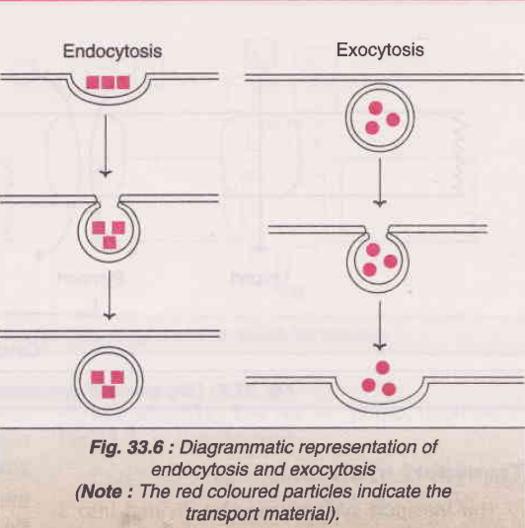

Slide 17


